Slide 1
Network Design Recommendations
Laxita Jain, Sterling McTee, Derric Denniston, Haein Ahn, Jaya Venkata Challagulla

Slide 2
Who did what
Critical Components - Sterling
VLAN Segmentation - Derric
DHCP configs - Sterling
IP Addressing & NAT Rules - Laxita
DNS configs - Laxita
Firewall Rules - Snehith/Derric
New device prices & secure network management - Haein
Everyone worked on Topology

Slide 3
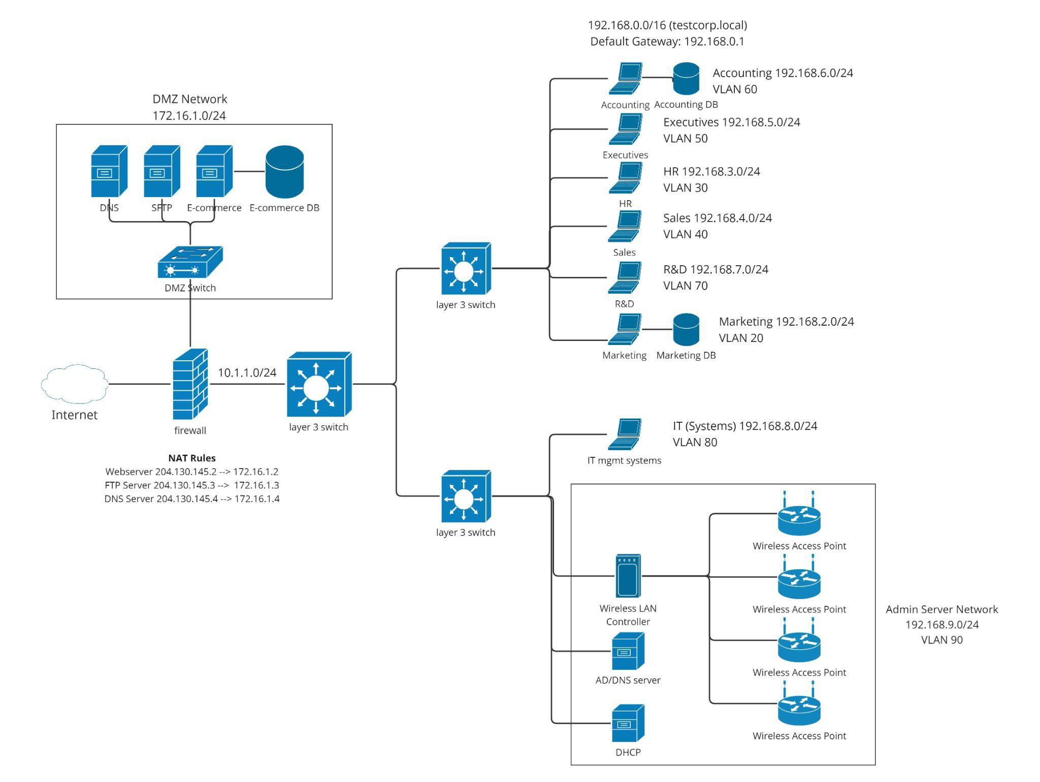
Recommended Network Design
Notes:
Derric

Slide 4
Critical Components
Firewall
Next-Generation firewall provides the best network edge security
Filter incoming and outgoing traffic, monitor network activity
Routing/switching
Versatility of layer 3 switches
Stackable design allows easy expansion as required
Provide for network segmentation
Wireless LAN
Wireless infrastructure allows wireless devices
Intrusion Prevention System
IDS/IPS systems provide monitoring and security across the network
Identify and react to threats as they occur
Notes:
Derric

Slide 5
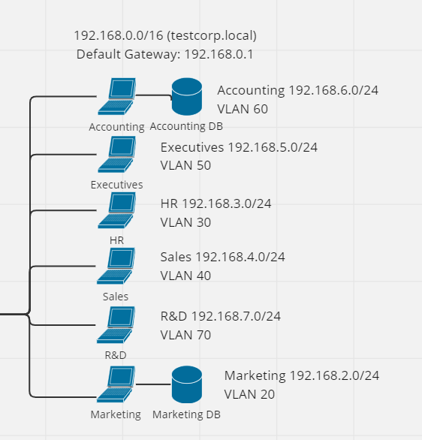
VLAN Segmentation
Department | IP Address | VLAN
Marketing | 192.168.2.0 | VLAN20
Sales | 192.168.4.0 | VLAN40
HR | 192.168.3.0 | VLAN30
Executives | 192.168.5.0 | VLAN50
Accounting | 192.168.6.0 | VLAN60
IT (Systems) – Privileged users | 192.168.8.0 | VLAN80
R&D | 192.168.7.0 | VLAN70
Admin Server Network | 192.168.9.0 | VLAN 90
VLANs
Notes:
Derric

Slide 6
IP Addressing Scheme
Public facing:
Webserver 204.130.145.2
FTP Server 204.130.145.3
DNS Server 204.130.145.4
DMZ: 172.16.1.0/24.
NAT will translate public IP’s to the following:
Webserver 172.16.1.2
FTP Server 172.16.1.3
DNS Server 172.16.1.4
EcommerceDB 172.16.1.5 (No public-facing IP)
Internal address space: 192.168.0.0/16
Internal addresses
Notes:
Laxita

Slide 7
NAT Rules
Static
Webserver 204.130.145.2 --> 172.16.1.2
FTP Server 204.130.145.3 --> 172.16.1.3
DNS Server 204.130.145.4 --> 172.16.1.4
Dynamic
204.130.145.10 <--> 192.168.0.0/16
204.130.145.0/24 192.168.0.0/16
172.16.1.0/24
NAT
Notes:
Laxita

Slide 8
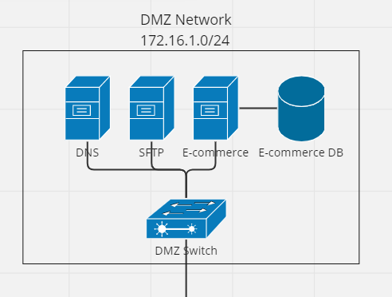
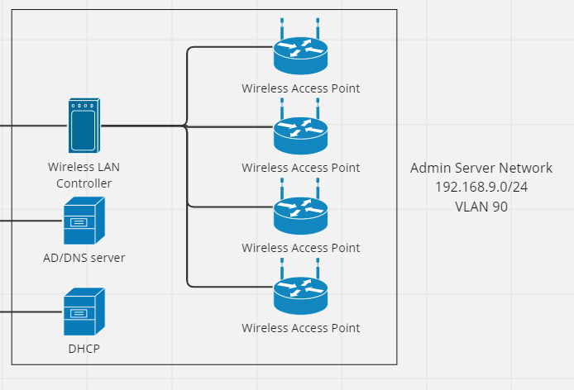
DNS Architecture
External DNS
testcorp.com
Internal DNS
testcorp.local
Notes:
Laxita

Slide 9
DNS Configurations
Internal
DNS Server Name: dc.testcorp.local
Domain: testcorp.local
External
DNS Server Name: dc.testcorp.com
Domain: testcorp.com
Name | Type | Data
dc.testcorp.local | A | 192.168.9.2
dhcp.testcorp.local | A | 192.168.9.3
marketing.testcorp.local | A | 192.168.2.100
accounting.testcorp.local | A | 192.168.6.100
rnd.testcorp.local | A | 192.168.7.100
Name | Type | Data
testcorp.com | A | 204.130.145.2
ftp.testcorp.com | A | 204.130.145.3

Slide 10
DHCP
VLAN20: Marketing
DHCP enabled
VLAN30: HR
DHCP enabled
VLAN40: Sales
DHCP enabled
VLAN50: Executives
DHCP enabled
VLAN60: Accounting
DHCP enabled
VLAN70: R&D
DHCP enabled
VLAN80: IT systems, administration systems, wireless, etc.
No DHCP, static addressing
Notes:
Sterling

Slide 11

Firewall Rules
Allow HTTP (port 80) and HTTPS (port 443) traffic from all VLANs to the internet for general web browsing.
Reason: To enable users to access the internet for work-related tasks.
Allow DNS (port 53) traffic from all VLANs to the internet.
Reason: To allow users to resolve domain names.
Allow SSH (port 22) traffic from the IT (Systems) VLAN (VLAN80) to all other VLANs.
Reason: To enable IT administrators to remotely manage and troubleshoot network devices.
Allow RDP (port 3389) traffic from the IT (Systems) VLAN (VLAN80) to all other VLANs.
Reason: To enable IT administrators to remotely access and manage user workstations.
Allow SMB (port 445) traffic within the Marketing (VLAN20), Sales (VLAN40), HR(VLAN30), Executives (VLAN50), Accounting (VLAN60), and R&D (VLAN70) VLANs.
Reason: To enable file sharing within each department.
Allow SMB (port 445) traffic from the IT (Systems) VLAN (VLAN80) to all other VLANs.
Reason: To enable IT administrators to manage shared files and resources.
Notes:
Snehith

Slide 12
Firewall Rules cont.
Allow access to an intranet web server on port 8080 from all VLANs.
Reason: To provide access to an internal company portal or knowledge base.
Allow VoIP (port range 5060-5061) traffic within and between all VLANs.
Reason: To enable voice communication within the organization.
Allow access to a VPN server on port 1194 from all VLANs to the IT (Systems) VLAN(VLAN80).
Reason: To enable secure remote access for authorized users.
Allow access to a network monitoring tool on port 3000 from the IT (Systems) VLAN (VLAN80) to all other VLANs.
Reason: To enable IT administrators to monitor network performance and troubleshoot issues.
Allow traffic from wireless access points (WAPs) to the internet on TCP ports 80, 443, and 53.
Reason: This rule allows WAPs to access the internet for legitimate business purposes, such as providing wireless connectivity for employees and guests. Restricting access to only necessary ports (HTTP, HTTPS, DNS) helps to minimize the attack surface and reduce the risk of unauthorized access.
Deny all other traffic not mentioned above.
Reason: To secure network by preventing any other communication that does not fall under given firewall rules
Notes:
Snehith

Slide 13
New Devices/Purchases
Firewall
Cost: $4,014.99
Benefit: Enhance network security by filtering traffic from the Internet
Layer 3 Switches
Cost: 24 port - $5319.99 each (purchasing 2) / 48 port - $6939.99 each (purchasing 2)
Benefit: Provide faster routing, scalability, flexibility and cost-effectiveness compared to router
Wireless Access Points/ Wireless Controller
Cost: $369.99 each (purchasing 4) / $6076.99
Benefit: Allows hosts to connect wirelessly
Intrusion Prevention System
Cost: $772.99
Benefit: Layer of security that will help protect against malicious content entering the network
Warranty/Service Agreements/Licenses
Cost: $8,366.77
Total : $46,777.64
Notes:
Sterling

Slide 14
Secure Network Management and Help Desk Workstation
Strong Authentication: Use complex passwords, multi-factor authentication to access servers and resources
Privileged Management: Implement RBAC and ABAC to ensure privileged users can access to the specific resources they are allowed and monitor and audit their activities
Limit Access: Limit access to servers and resources to the necessary users and provide access on need-to-know basis
Security Audits: Perform regular audits to identify vulnerabilities to address them
User Awareness Training: Provide training to all users and especially users who have privileged access to educate them on security best practices and the importance of secure network
Patching: Keep all software and systems up-to-date with latest security patches and to keep them secure
Encryption: Implement TLS or SSL to secure data at transit and at rest to protect against data from unauthorized access
Notes:
Haein

